Slide 1

Python Course Chapter 8
Error Handling and Exceptions

Slide 2
What’s Exception?
In the life cycle of a program, we might encounter some problems. They can be categorized into 3 different kinds:
Grammar Mistake – this happens when we have invalid syntax in Python; for example, we might forget to put : at the end of a if statement. When this happens, program won’t run.
Logic Mistake (a.k.a. bugs) – this happens when we have valid syntax in Python, but the result is not something we are expecting; for example, we type the wrong formula for calculating a circle’s area. Programmers have to solve this.

Slide 3
What’s Exception?
Exceptions – this happens when there’s no syntax error nor bugs in our codes, but accidents just happen. For example, our program wants to read a file by using the open() function, but the file doesn’t exist; or we are asking the user to input their age (should be an integer), but they type words, such as “I am ten years old.”
Traditionally, there are 2 approaches to handle exceptions. The first one is called LBYL (Look Before You Leap), and the second one is called EAFP (Easier to Ask Forgiveness than Permission).
In Python, we do EAFP approach to handle exceptions!!
*. The word “Leap” is used from the English quote “A leap in the dark.”

Slide 4
EAFP vs LBYL
Some benefits of using EAFP includes:
If we use LBYL, then most of our codes are doing error handling. This decreases the readability of codes.
EAFP is usually faster than LBYL, since we don’t need to stop and check all the conditions and possible problems before we execute codes.
EAFP can reduce race conditions. The race condition is an idea in Operating System; it means that 2 threads are trying to access and change the same object. A race condition is something we don’t want to see.

Slide 5
EAFP vs LBYL
EAFP can avoid errors during condition checking and the actual execution of codes. For example, we have LBYL codes:
If (a file exists):
open the file and read the content
Then, after we check the file exists, before we open the file and read the content, there’s a chance that other programs go ahead and delete the file. Therefore, even if we check the file exists, we still cannot avoid getting it during execution, and the whole program might just crush.

Slide 6
EAFP vs LBYL
On the other hand, if we do EAFP, then we would do:
try:
open the file and read the content
except:
# some error handling codes here
Then, we open the file directly. If we get some problems, we can handle that exception during execution, and the program won’t just crush.

Slide 7
EAFP vs LBYL
Is EAFP perfect? Nope. There are other cases when we would prefer LBYL. For example,
We are doing a task that is computationally heavy and time consuming. Then, if we execute the code first, and handle exceptions later, that would cost more time to finish running the codes. It would be better to check everything is fine before we run the code.
If we are doing an important task that is costly to trace back, we should do LBYL instead of EAFP.

Slide 8
Python Exception
Each Python exception is an object of its exception class. (It’s okay if this sounds too vague for now; we will see some examples later.)
Python exception classes are based on the OOP principle; that means that one exception would inherit from another exception.
The inheritance relations can be found on
https://docs.python.org/3/library/exceptions.html
When we tend to run some codes that might cause problems, we can put it into a try block.

Slide 9
General Syntax of Exception Handling
try: # main codes right here
except ExcpetionName1 as variable1:
# exception handling code here
except ExcpetionName2 as variable2:
# exception handling code here …
else: # some codes here finally: # some other codes here
this part will be executed if we have exceptions
else will run when there’s no exception
finally will run no matter we have exception or not

Slide 10
General Syntax of Exception Handling
Rules Note:
When doing exception handling, we must have both try and except.
As is optional for except.
Except will run if try has an error.
Else and finally are optional.

Slide 11
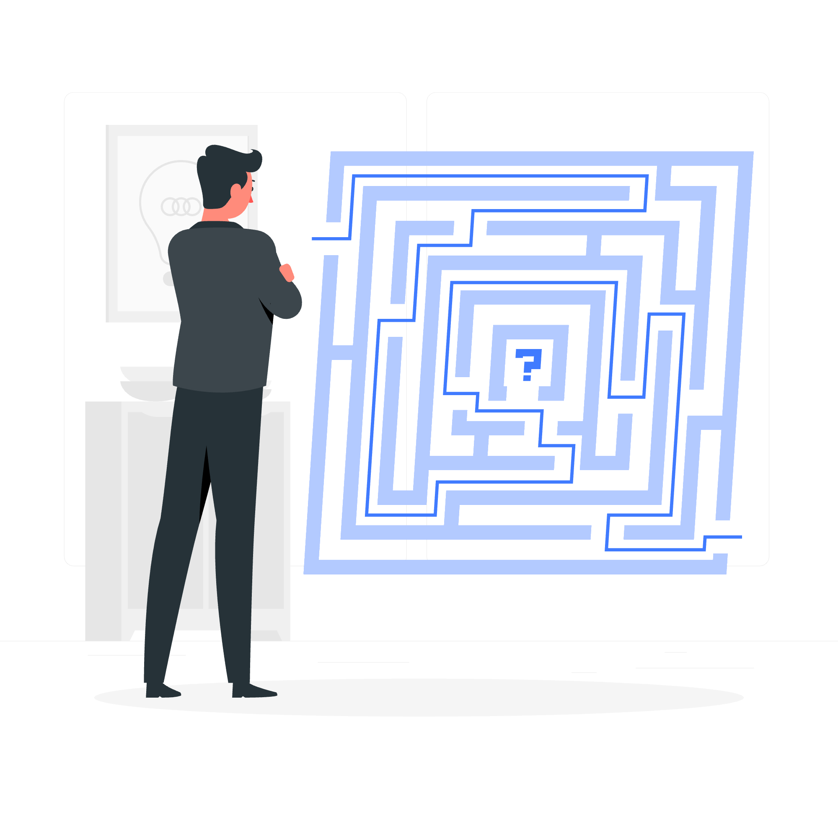
Common Errors and Exceptions
The following examples are some extremely common errors and exceptions we should know:
TypeError
ZeroDivisionError
NameError
RecursionError
KeyError
IndexError
ValueError
FileNotFoundError

Slide 12
Raise an Exception
If we were trying to write codes for other people to use, they might misuse our functions; then, we should raise an exception for them to catch.
In Python, all exceptions must be instances of a class derived from BaseException. Therefore, when defining our own exception class, we need to at least make it inherit from BaseException. (Otherwise, we will get TypeError.)
If a function wants to throw an exception, then we use the keyword raise.

Slide 13
Order of Exception
The order of putting exception codes matters; it could be affected by the hierarchical structure of exceptions classes.
For example, we know that LookupError class has 2 child class:
IndexError (happens in list)
KeyError (happens in dict)
That means that any instance of IndexError and KeyError also belongs to the LookupError class. If we put LookupError before IndexError or KeyError, then LookupError is going to catch all both types of errors, and the IndexError and KeyError codes will never be reached.

Slide 14
Guard Clauses and Exception Handling
When we are writing a function, we might encounter this situation:
def function():
if thing A is right:
do thing A
if thing B is right:
do thing B
if thing C is right:
do thing C
…

Slide 15
Guard Clauses and Exception Handling
Multiple layers of if statement makes the code look messy and complex. This structure is known as the “guard clauses.” We can improve and structure and readability of the codes by using Exception Handling.
def function():
if thing A is not right:
raise Exception1
do thing A
if thing B is not right:
raise Exception2
do thing B
…

Slide 16
Context Manager
When we learned about I/O in Python, we talked about the syntax with; right now, we will learn the true meaning behind it.
Traditionally, if we are working with files, we have to put open in try block (otherwise we might get FileNotFoundError). The code will look like:
try: file = open(“hello.txt”) data = file.read() file.close() except FileNotFoundError: print(“file not found…”)

Slide 17
Context Manager
This is how Java and many other programming languages deal with I/O. In Python 3, Context Manager is introduced with a better way to do this. When we use the keyword with to mark an object, after we leave the with block, Context Manager will execute the action to close the object.
That’s is why we recommend using with keyword when working with files. Context Manager is very useful to work with I/O, database, and working with resources.
*. If interested, you can read the Python documentation contextlib to learn how to customize your own context manager.

Slide 18

Pylint
Pylint is a Python static code analysis tool that looks for programming errors, helps enforce a coding standard, sniffs for code smells, and offers simple refactoring suggestions.
First, we do:
pip install pylint
In the command line.

Slide 19
Pylint
If we are coding in Java or C++, the compiler will usually lend a helping hand. But if we are coding in a dynamic language like Python, we are on our own: we don’t have a compiler to catch bugs. For example,
def hello():
for volume in [1, 2, 3]:
print(volume)
for volme in [1, 2, 3]:
print(volume)
Could you find the bug in this block of code?

Slide 20
Pylint
Pylint uses heuristics to catch bugs in your code. If we run this code with Pylint, it would show we have unused variables.
Pylint is helpful, but many projects don’t use it. For example, neither Twisted, Django, Flask, or Sphinx seem to use Pylint. Why wouldn’t these large, sophisticated Python projects use it?
Well, it’s because Pylint has particular styles and rules of how we should write our codes. If our project is huge, it will give many useless suggestions.
Then, how should we use Pylint? We can create a .pylintrc file in our project and then disable all unnecessary functionalities in Pylint.

Slide 21

Unit Testing
A module in Python’s standard library called unittest contains tools for testing your code.
Unit testing checks if all specific parts of your function’s behavior are correct, making integrating them with other parts of our project much more effortless and manageable.

